Slide 1

Eigenvalue-Based Preprocessing for Tissue Extraction
From Pathology Image slides
Do-Hyun Lim¹
Department of Computer Science, Hanyang University, Seoul, Republic of Korea
ldh991014@hanyang.ac.kr
Introduction
In various biological fields, tissue samples are frequently collected from subjects and analyzed as image slides. These pathology image slides often contain not only the tissue of interest but also extraneous elements, including background regions and markings, which can compromise analysis accuracy.
To accurately isolate tissue regions, precise preprocessing is essential. By extracting each element’s features using simple algorithms, we can effectively distinguish tissue from unwanted elements.
Objective
Results
Extract eigenvalues and eigenvectors from patches containing each element to analyze their features.
Set an appropriate threshold to extract only tissue.
<결과 패치 사진>
Tissue Adipose
Back Marking
Method
<pseudo-code>
1
2
3
…
<eigval로 구분 되는 이유>
Eig_1 & Eig_2 Plot 포함
Conclusion

Slide 2
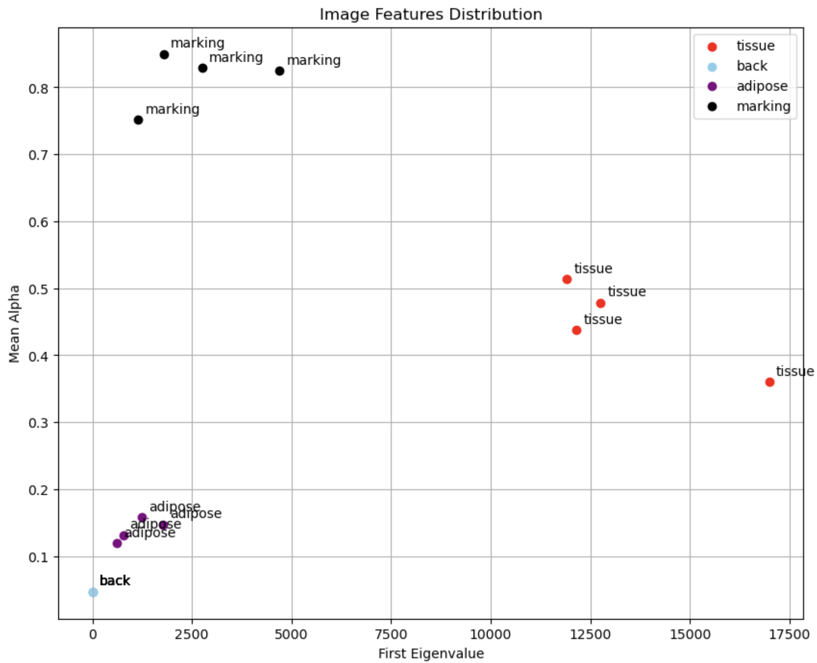
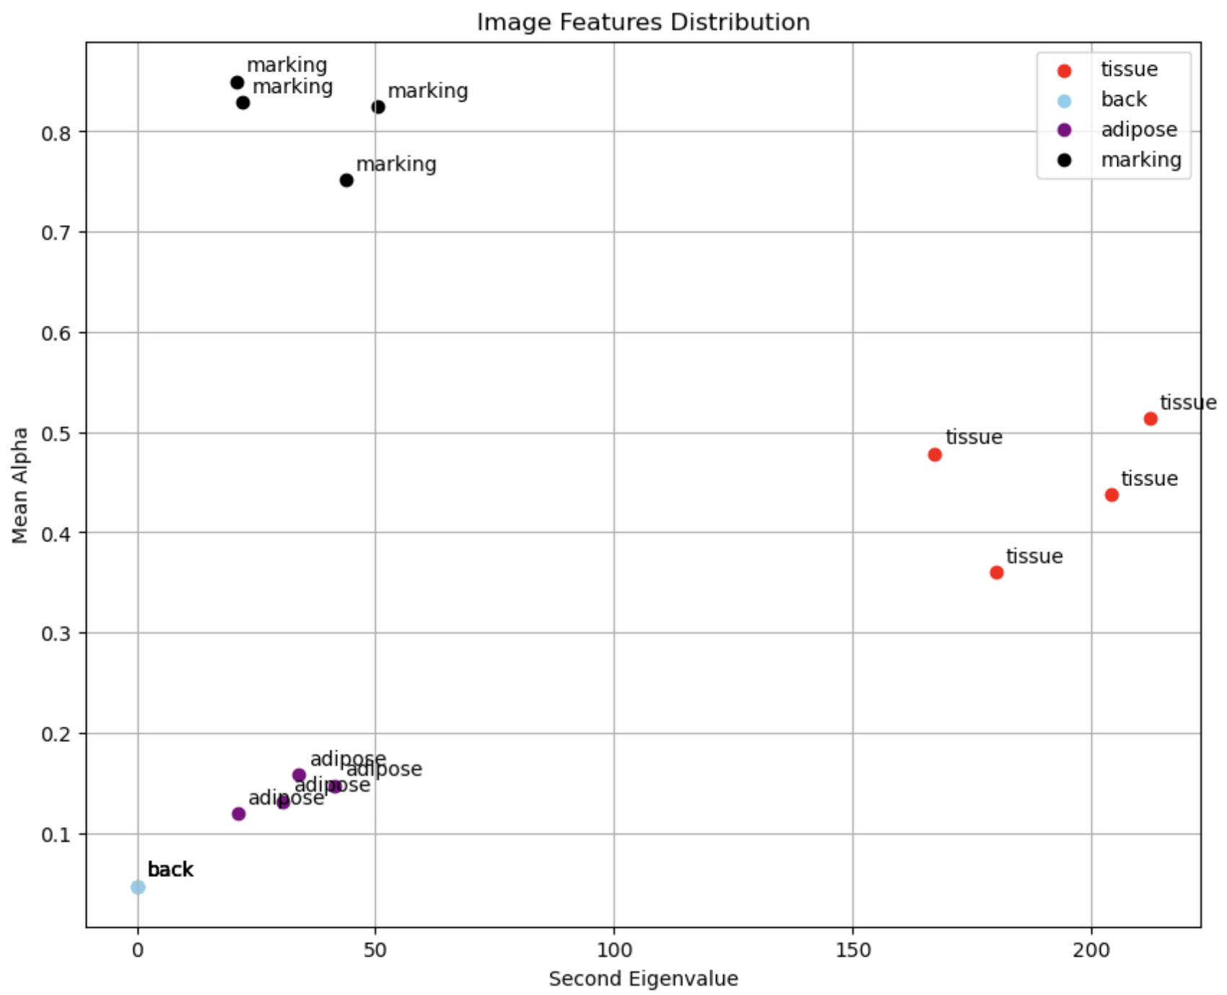
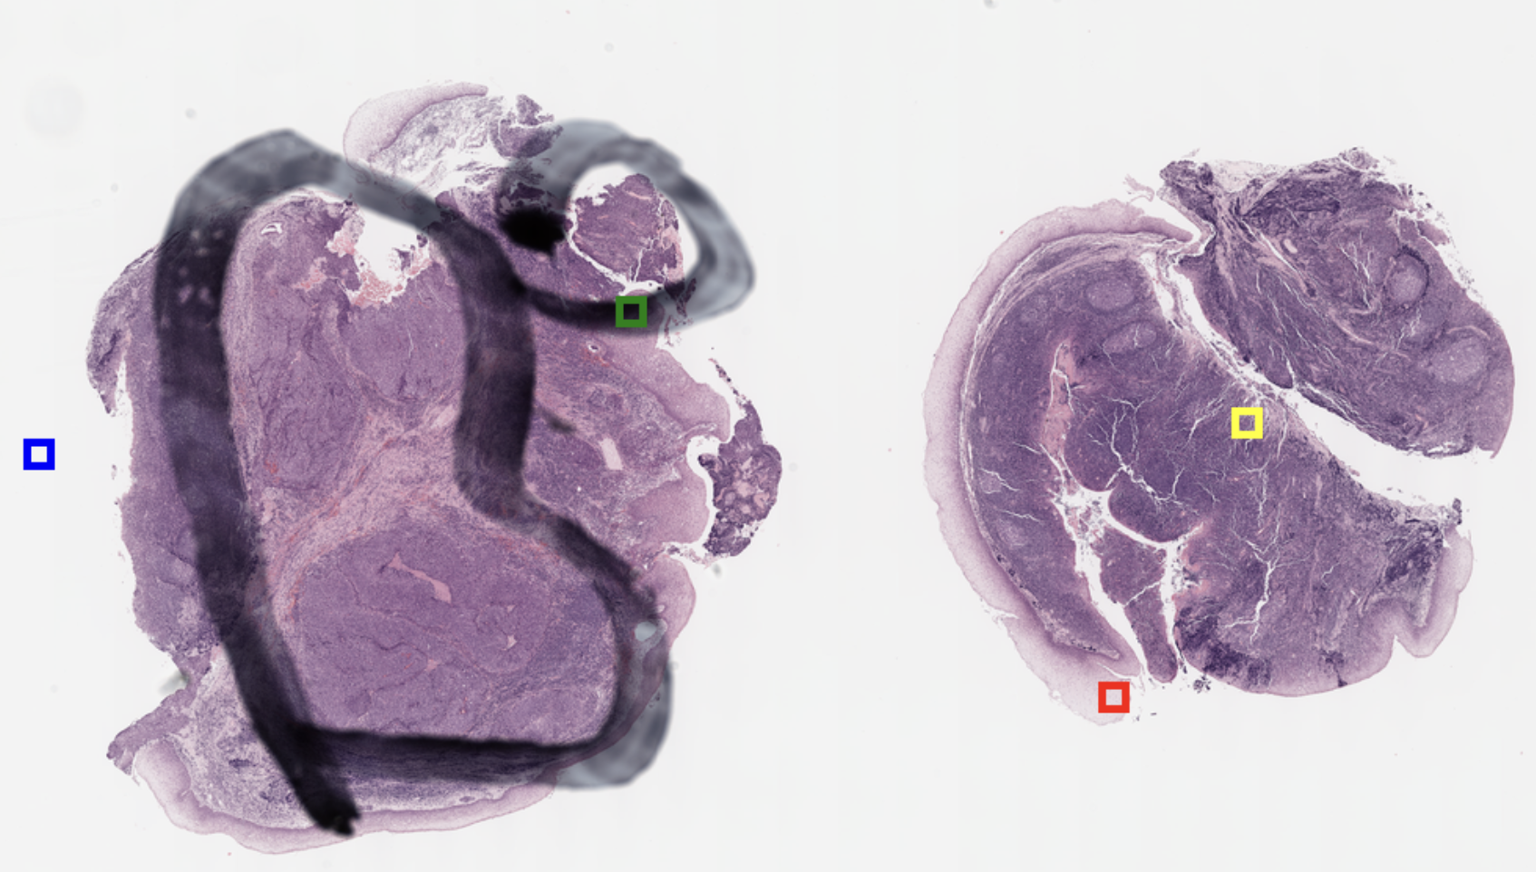
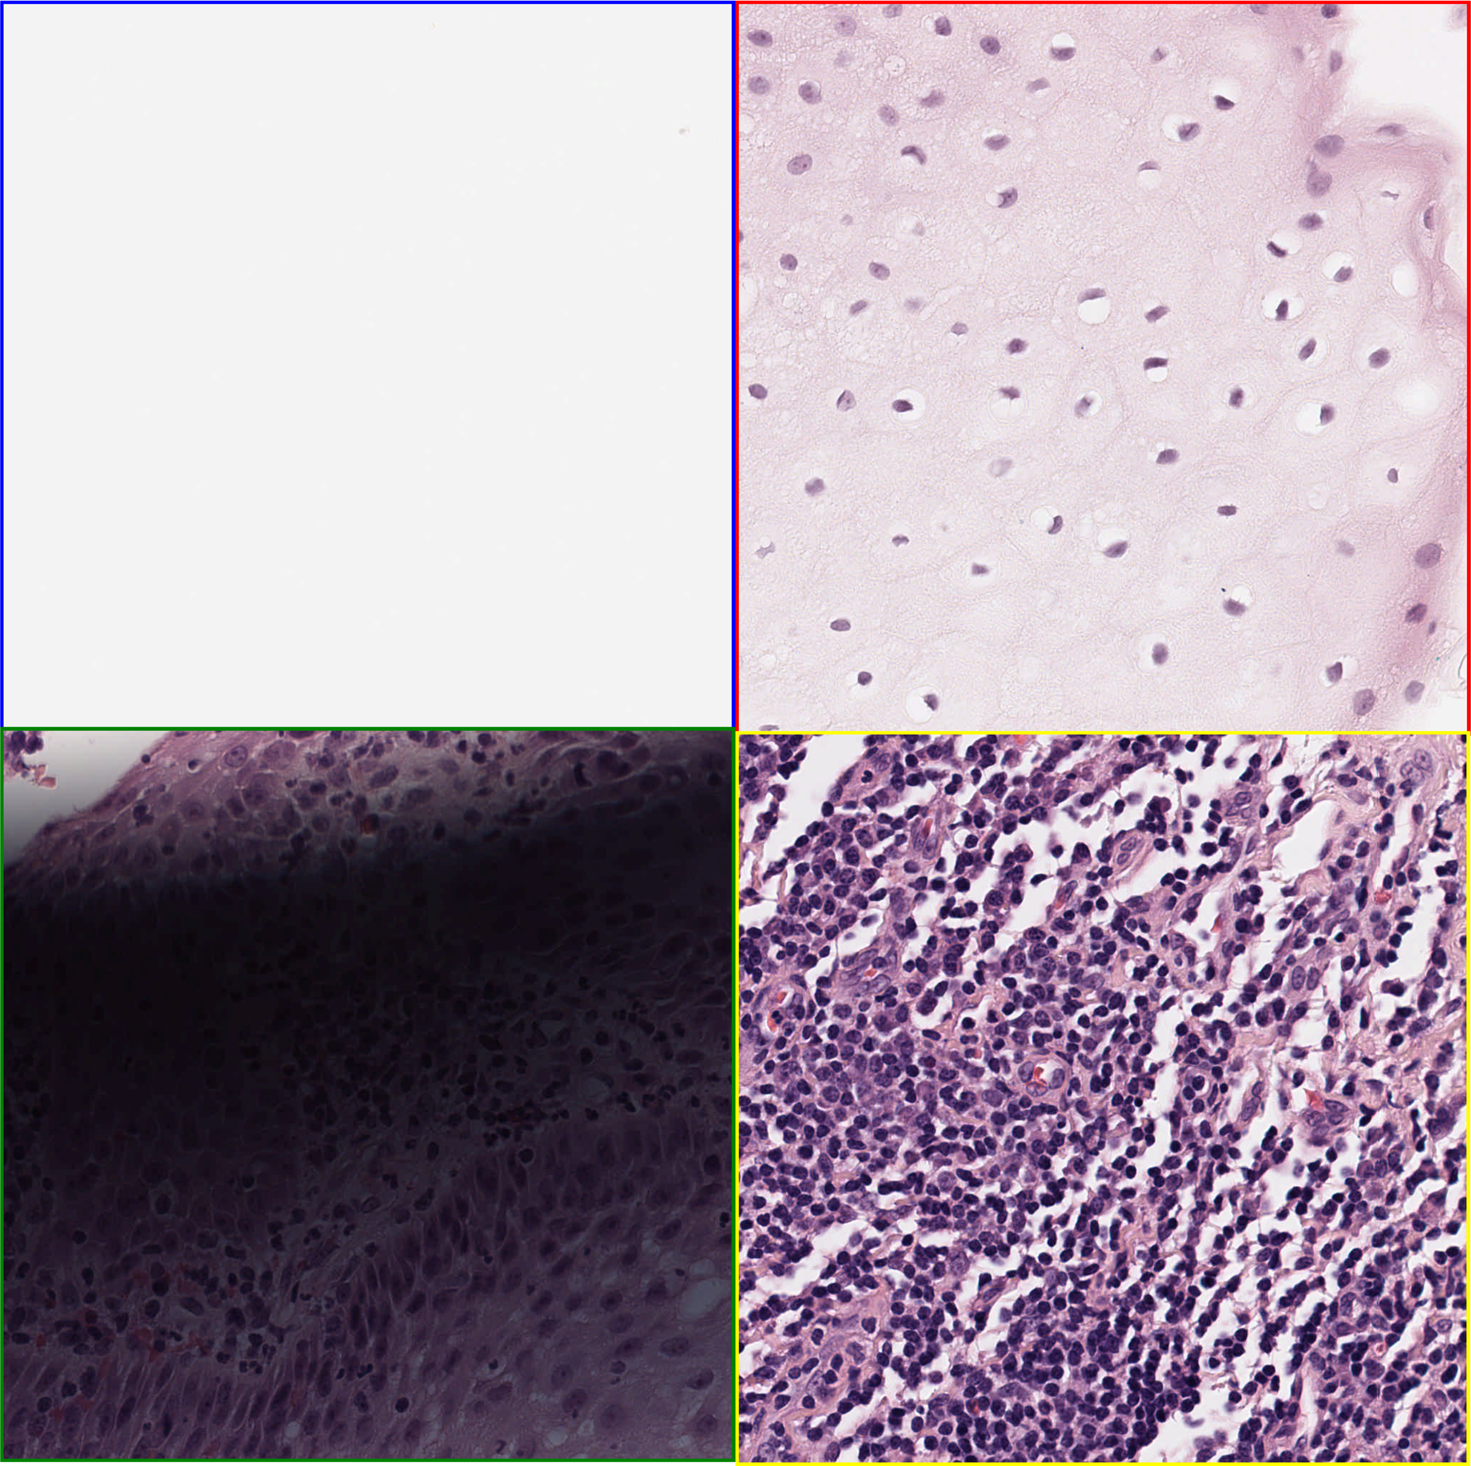
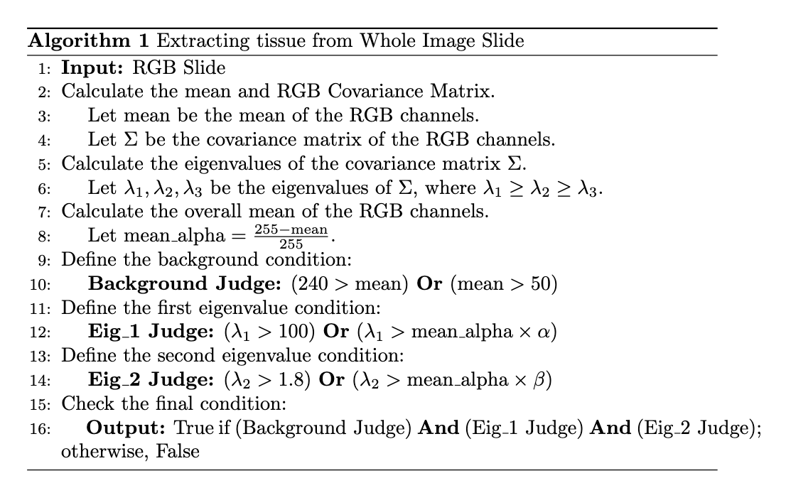
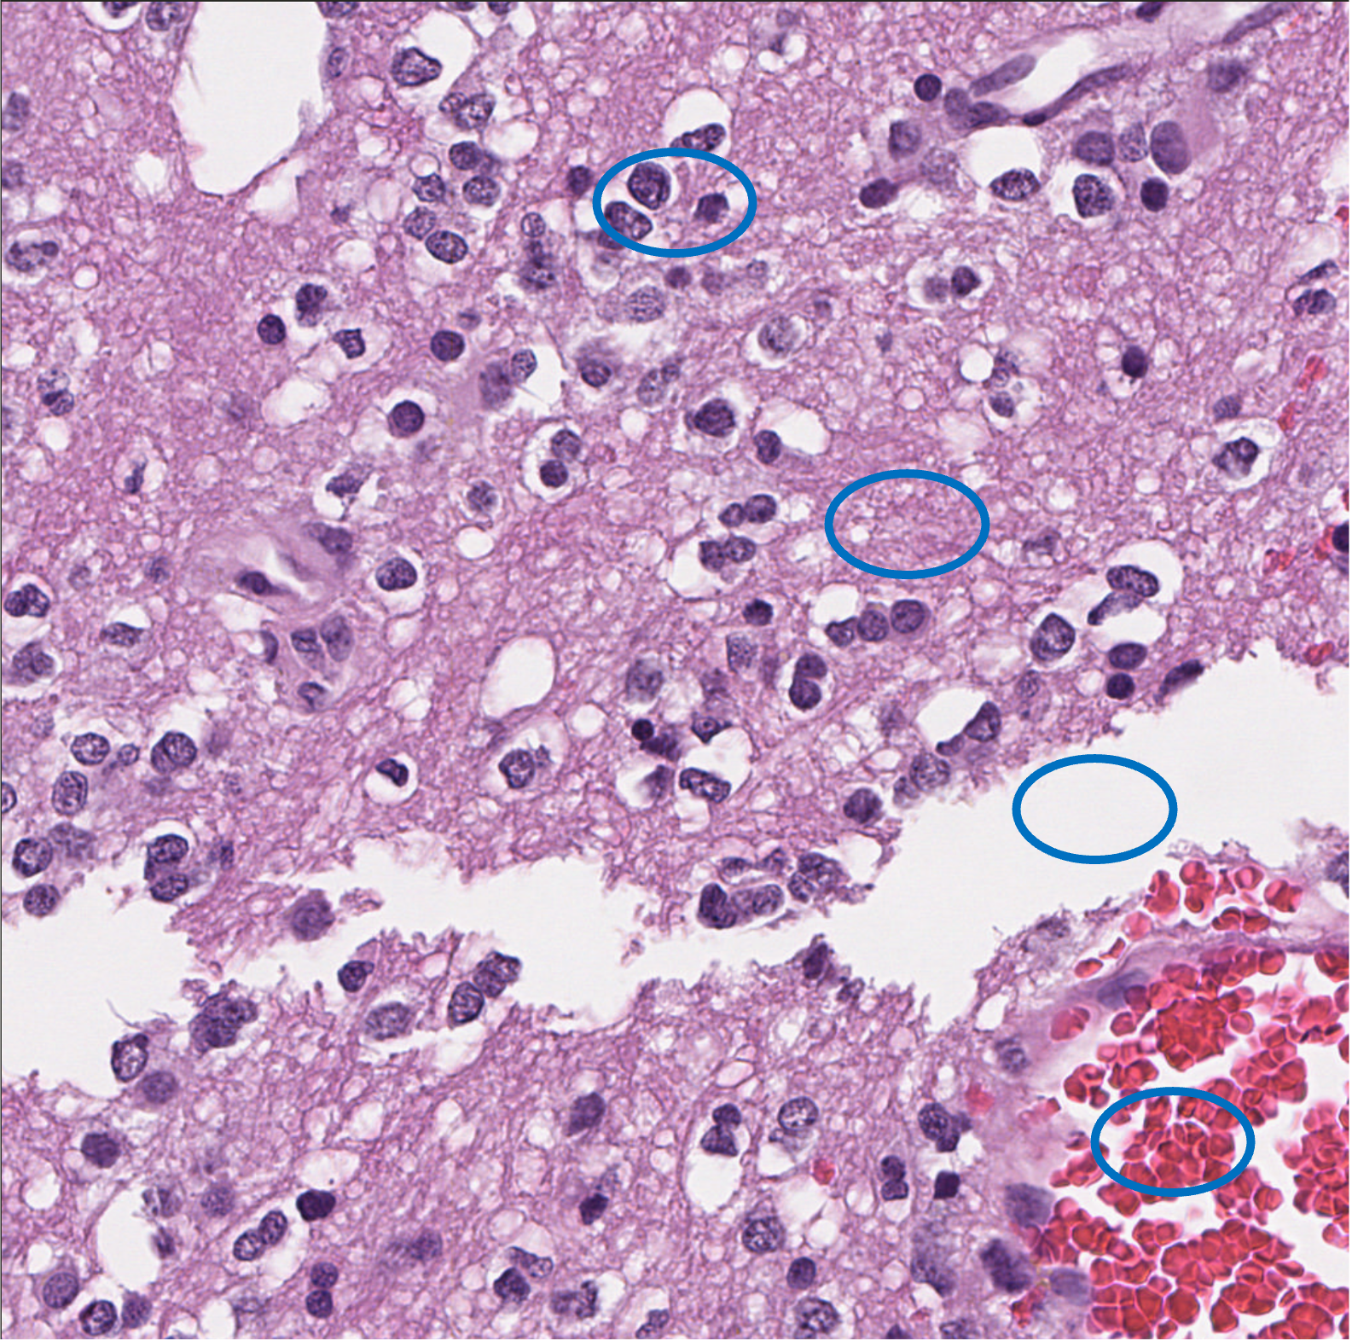
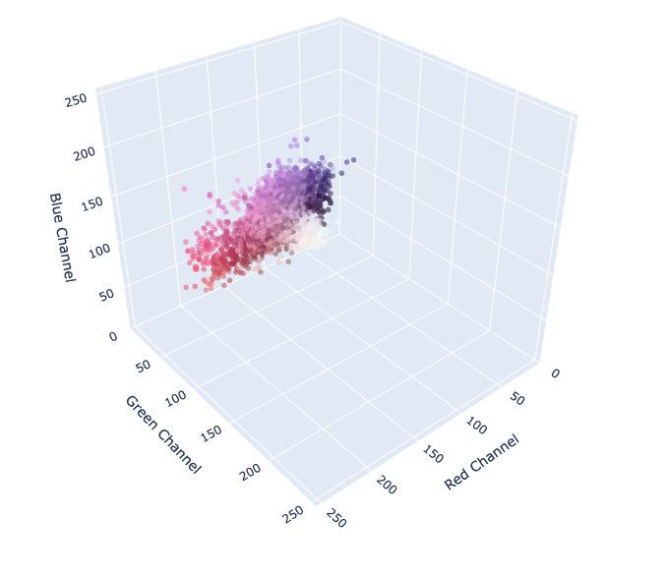
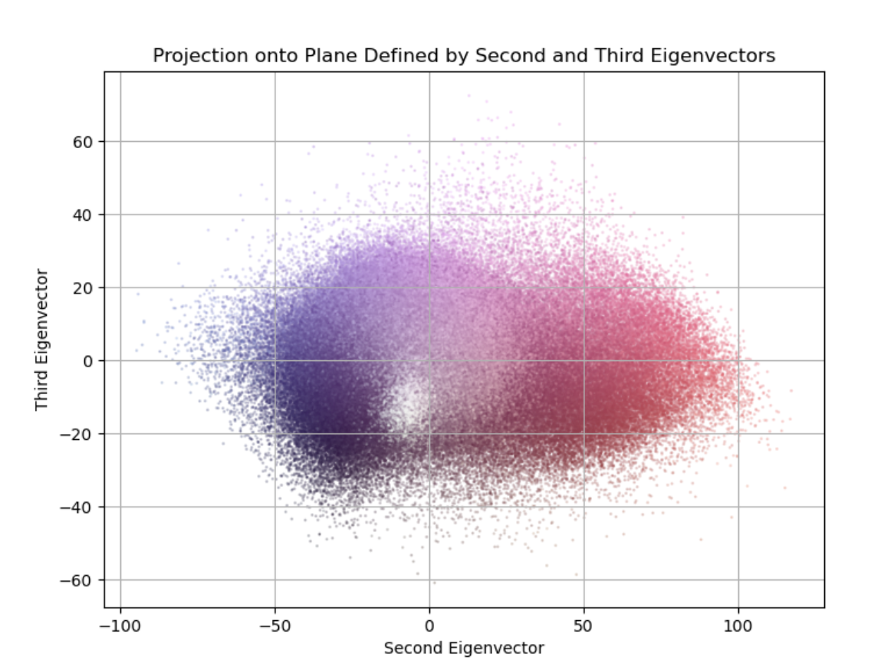
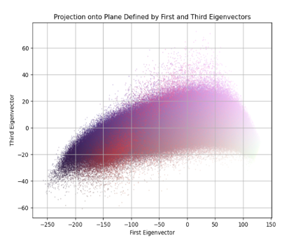
Eigenvalue-Based Preprocessing for Tissue Extraction
From Pathology Image slides
Do-Hyun Lim¹
Department of Computer Science, Hanyang University, Seoul, Republic of Korea
ldh991014@hanyang.ac.kr
Introduction
In various biological fields, tissue samples are frequently collected from subjects and analyzed as image slides. These pathology image slides often contain not only the tissue of interest but also extraneous elements, including background regions and markings, which can compromise analysis accuracy.
To accurately isolate tissue regions, precise preprocessing is essential. By extracting each element’s features using simple algorithms, we can effectively distinguish tissue from unwanted elements.
(a)
(b)
Figure 3. (a) Plot with first eigenvalue as X-axis and mean_alpha as Y-axis (b) Plot with second eigenvalue as X-axis and mean_alpha as Y-axis
Eig_1 Judge: First, Detatch the backgrounds
Eig_1 Judge & Eig_2 Judge: Then, Among other remaining features, marking becomes linearly separable from tissue and adipose.
Objective
Extract eigenvalues and eigenvectors from patches containing each element to analyze their features.
Set an appropriate threshold to extract only tissue.
With these three judges, we can completely extract only tissues.
Results
Method
Figure 4. Project the RGB points of an image onto a plane represented in three dimensions, with the first and second eigenvectors as normal vectors, respectively.
Our algorithm-based experiments demonstrate that it is good at extracting tissue-only patches from whole slide images and can quickly separate the tissue from the background in an image, which is advantageous when processing large amounts of data at once.
Figure 1. Pseudo Code for Patch Extraction
Background Judge: Average which is too large or too small, consider it background or marking
Conclusion
Patch
Clustered
Projection
We successfully demonstrated a straightforward and effective approach for distinguishing tissue regions from unwanted elements such as background and markings in pathology image slides. By leveraging eigenvalue-based criteria and simple preprocessing steps, our method isolates tissue regions with high accuracy. Using eigenvector directions as the basis for feature extraction, we were able to segment image patches based on their characteristic variance patterns, which efficiently separated tissue from extraneous elements.
Our method’s simplicity and robustness make it particularly advantageous for large-scale applications, allowing for rapid and accurate extraction of tissue-only data. This approach holds promise for improving analysis efficiency in biological and medical image processing by enabling a more focused examination of relevant regions.
Figure 2. Project the RGB points of an image onto a plane represented in three dimensions, with the first and second eigenvectors as normal vectors, respectively.
We found that eigenvectors classify features well.
We also found that the difference in the size of the eigenvalues for each feature was significant.

